Slide 1
Battleship
Katelynn Call & Cheston Gray

Slide 2
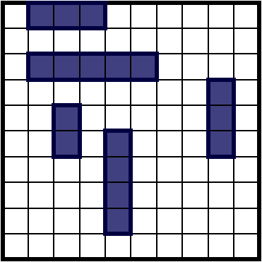
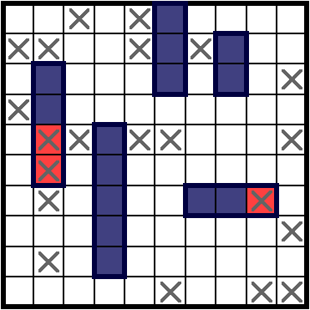
Quick Review and Rules For battleship
5 ships placed on a 10x10 grid
Carrier – length of 5
Battleship – length of 4
Submarine – length of 3
Destroyer – length of 3
Patrol Boar – length of 2
Players take turn “shooting” at the other players ship by calling out coordinates (a1), (b5), (j10), ect:
Object of the game is to sink the opponent's fleet.
If a hit sinks a ship it must be announced.
Because the grid is 10x10 there are 100 possible locations for a player to shoot.
Example of a game board
Example of a game in progress

Slide 3
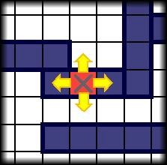
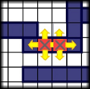
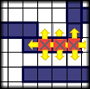
Basic Strategies and their statistics
Picking coordinates completely at random:
90% chance you’ll need more than 98 shots
50% chance you’ll need more than 96 shots
25% chance you’ll need more than 93 shots
10% chance you’ll need less than 89 shots
1% chance you’ll need less than 75 shots
Random Selection then “Hunting” down a hit
You select random coordinates until you score a hit, then systematically check the surrounding area.
90% chance you’ll need more than 83 shots
50% chance you’ll need more than 65 shots
10% chance you’ll need less than 50 shots
1% chance you’ll need less than 39 shots
“Hunting” strategy

Slide 4
A more Effective Solution:
Calculating the odds by using superposition of all possible locations for surviving ships.
Each square needs to add up how times it could be used as a legal move for:
Each of the remaining ships
Each segment of length for every remaining ship
Both vertically and horizontally
These calculations are going to be done in parallel.

Slide 5
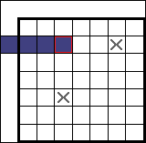
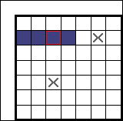
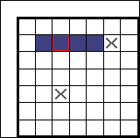
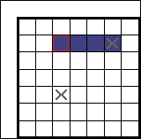
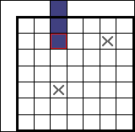
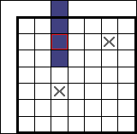
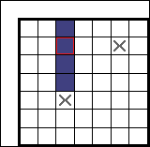
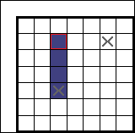
Superposition Calculation Example
There are 3 possible ways to arrange this 4-length ship.
We need to repeat this process for every square, and every remaining ship
Invalid: Out of Bounds
Valid
Valid
Invalid: Has already been hit
Invalid: Out of Bounds
Invalid: Out of Bounds
Valid
Invalid: Has already been hit

Slide 6

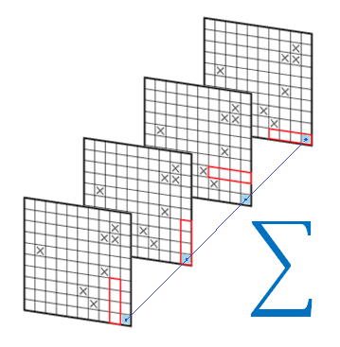
Statistics for Using Superposition:
Picking coordinates completely at random:
90% chance you’ll need less than 56 shots
50% chance you’ll need less than 43 shots
25% chance you’ll need less than 36 shots
10% chance you’ll need less than 32 shots
1% chance you’ll need less than 25 shots

Slide 7
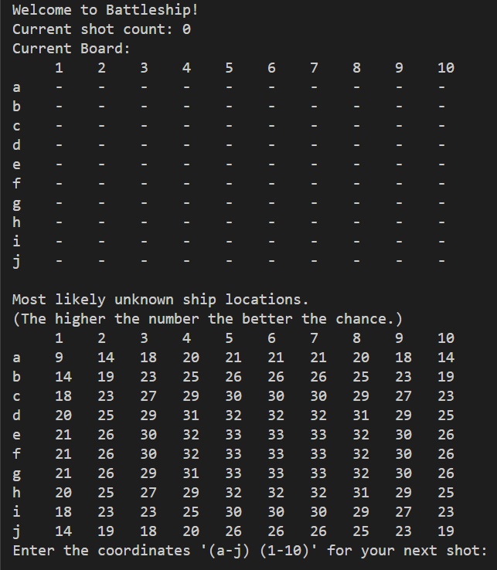
Output Example:
We’re given a game board and the superpositions calculated for each square printed below.
The higher the number the more likely a ship is located there.
At the start of a game it’s statically more likely that the ships will be touching the center of the board.

Slide 8
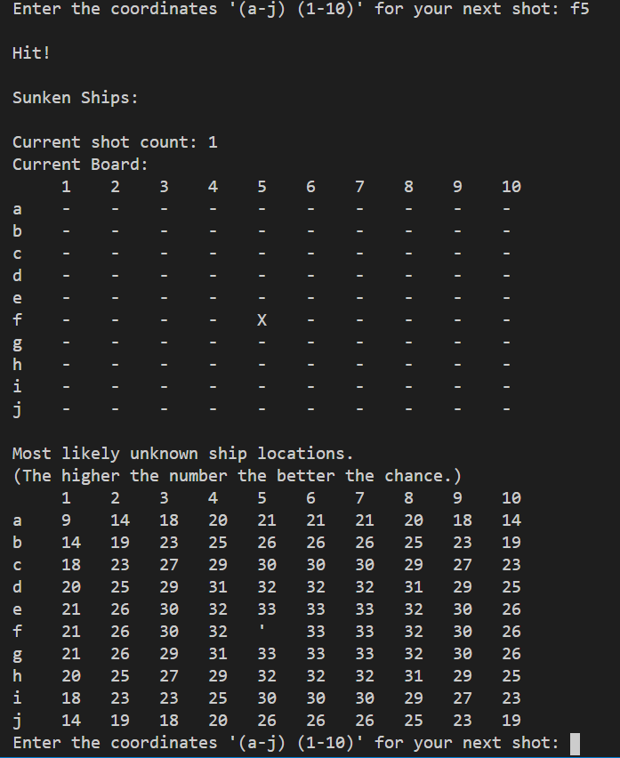
Output Example:
We took a shot at f5, which resulted in a hit!
The board shows us a hit with an ‘X’ and the probability board gets updated with new calculations.

Slide 9
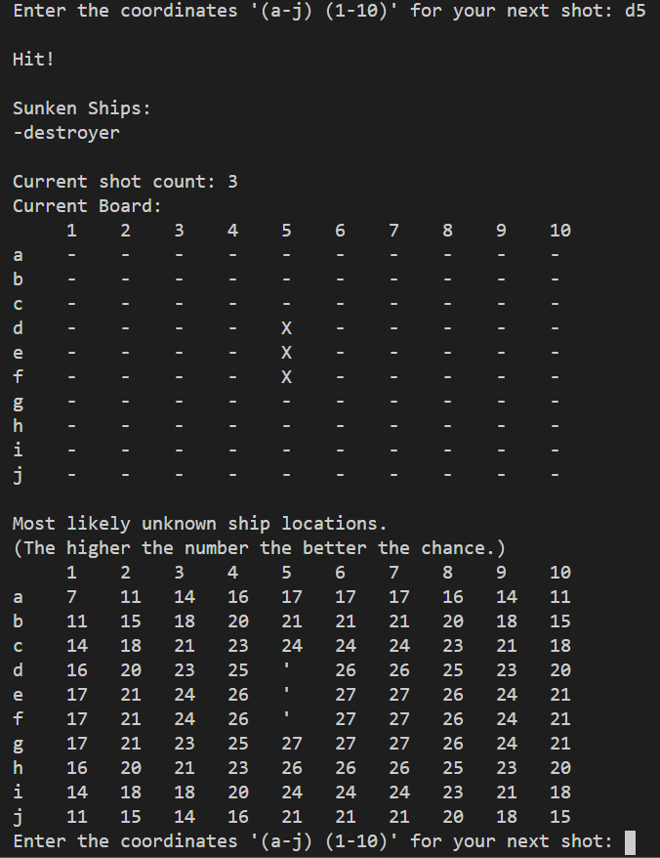
Output Example:
We got a bit lucky and managed to sink the first ship in our first three shots.
The console tells us which of the ships have been destroyed so far.
The average probability drastically dropped because we’re no longer searching for five ships, but four.
It looks like our next shot should be aimed towards near f7.

Slide 10
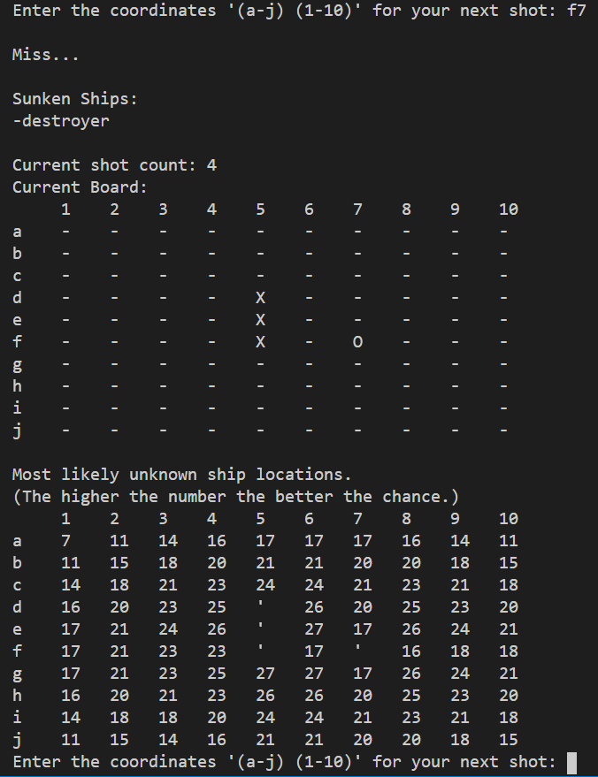
Output Example:
We’ve shot our first miss. It’s represented by a “0” on the board.
We can see that the number around the f7 shot dropped from an average of ~26 down to ~21.
The probability of squares that have already been targeted are irrelevant because ships can’t possibly be placed there.
Our next shot should probably be g5, because it’s the highest number on the board and is surround by high numbers as well.
g6 and e6 would also serve as decent targets.

Slide 11
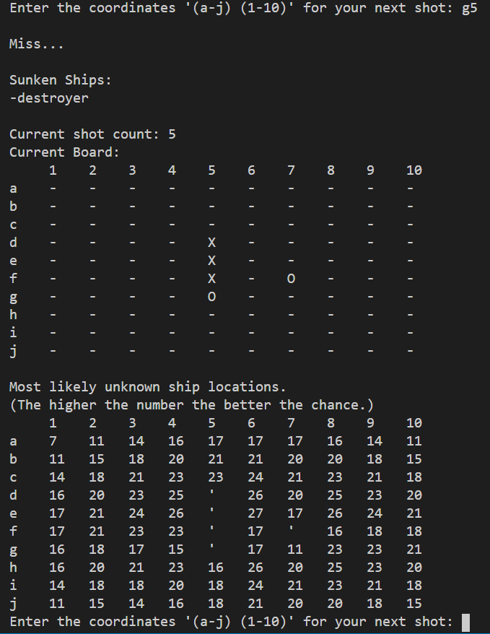
Output Example:
Another miss – that’s okay
Keep aiming towards the concentration of higher numbers until we score another hit.
Once a hit is scored; hunt it down until the ship gets sunk

Slide 12
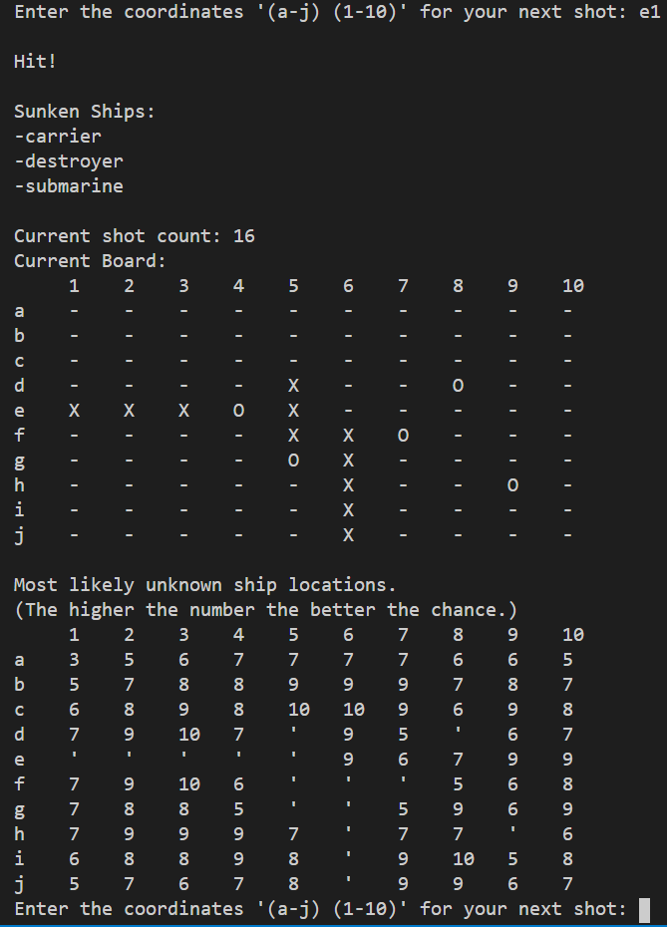
Output Example:
We’ve skipped ahead; three of the five ships have been sunk. We’re looking for the patrol boat (length 2) and the battleship (length 4).
We’ve got a lot of open water that could be hiding these two remaining ships; but the probability board gives us a pretty good idea of where to start.

Slide 13
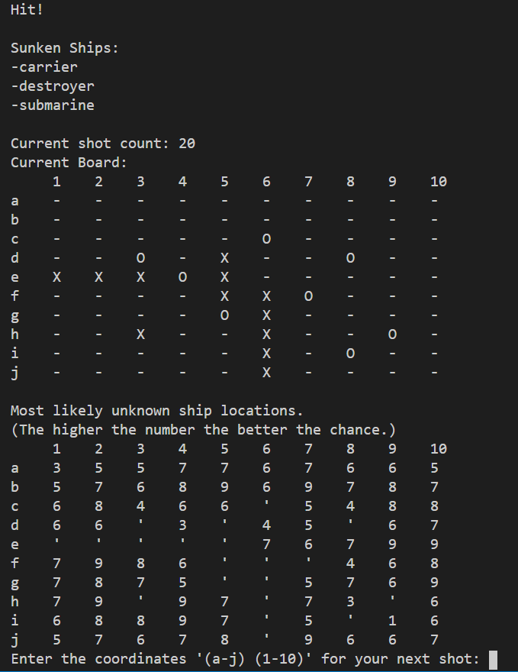
Output Example:
We’ve scored a hit; lets finish it off and start looking for the last ship.

Slide 14
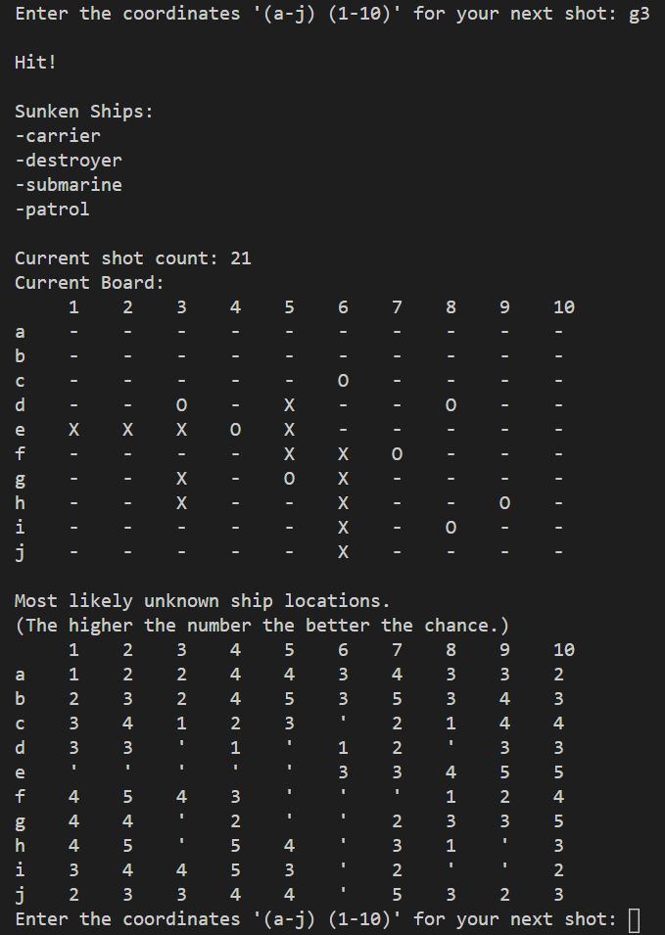
Output Example:
We’ve sunk the patrol boat! This is good news because it severely reduces the possible locations for the last possible ship to be.

Slide 15
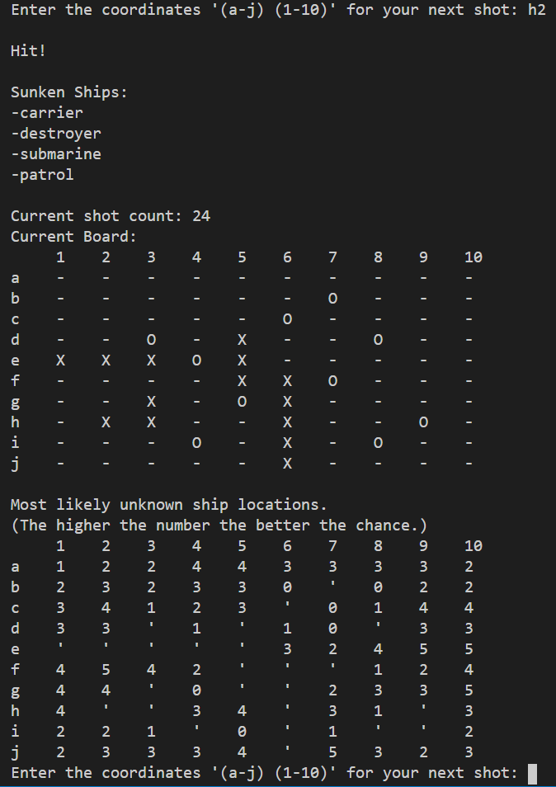
Output Example:
We’ve scored a hit on the last ship.
Let's finish it off and get our final score.

Slide 16
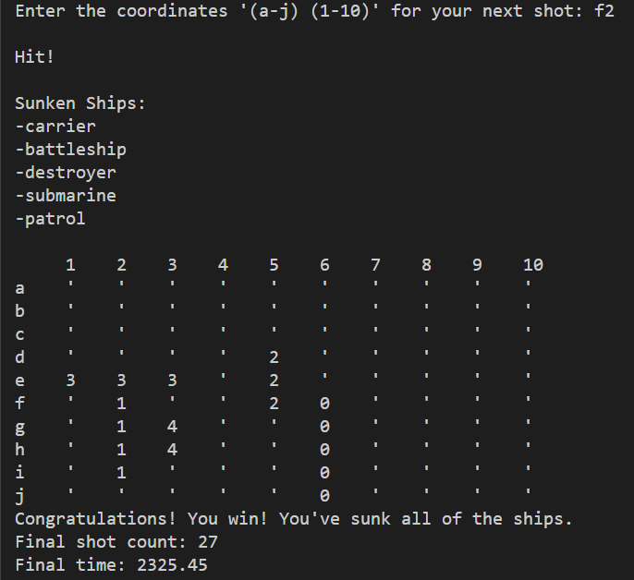
Output Example:
Congratulations!
We’ve sunk all the ships!
It only took us 27 shots!

Slide 17
Inspiration and works cited
The main inspiration for this project came from Cheston’s stupid competitive nature and wanting to let computers make smart decisions for him. (He’s really bad at making smart decisions.) After getting beat by his nephew over Christmas break in a game of battleship he’d had enough.
The statistics, math, and images used in this presentation came from http://www.datagenetics.com/blog.html. It’s a really cool site that explains statistical odds, probabilities, and algorithms for a variety of problems. We simply adapted them to run in parallel.
The actual page that talks about Battleship is:
http://www.datagenetics.com/blog/december32011/index.html

